Slide 1
Annual Earnings in Punjab Urban
ECO346 · Assignment 1 · Fall 2026
Variant 1: Punjab Urban
Sample: working people aged 15–64 with annual earnings above zero.
Data: PSLM 2019–20 person and household files.
3,768 earners
Weighted median: Rs 240,000
Weighted p10: Rs 96,000
Weighted p90: Rs 660,000
All statistics use household weights (hhweight), unless stated otherwise.

Slide 2
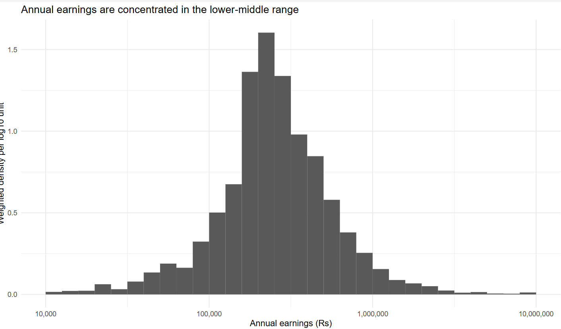
How are annual earnings distributed?
Question 2 · Earnings are spread widely across the sample
Figure 2: Weighted earnings distribution
Insert your figure 2: weighted earnings distribution SVG here
Key statistics
• Earners: 3,768
• Weighted median: Rs 240,000
• Unweighted median: Rs 240,000
• Weighted p10: Rs 96,000
• Weighted p90: Rs 660,000
• p90 / p10: 6.88
• Excluded from histogram range: 25

Slide 3
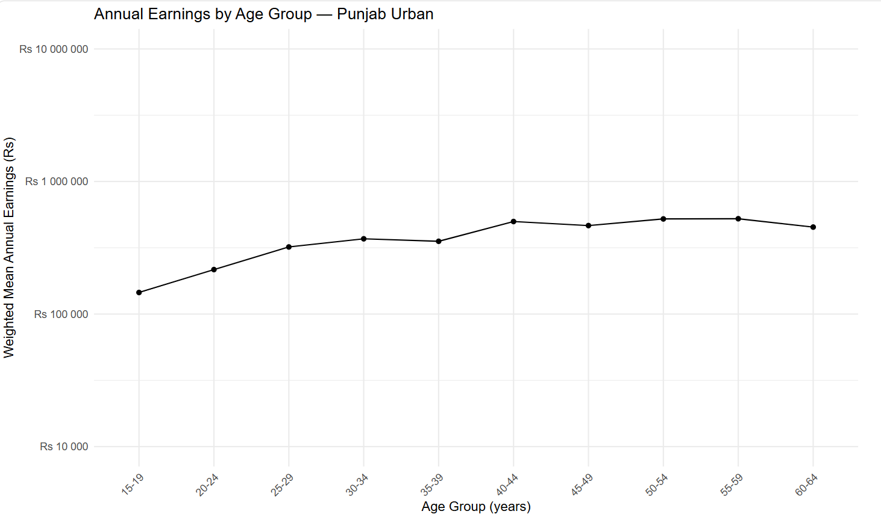
Earnings generally rise with age
Question 3 · Weighted means by five-year age band
Redesigned Figure 3
Insert your redesigned figure 3 SVG here
Highest weighted mean
Ages 55–59: Rs 523,751
25–29 band: Rs 320,776
45–49 band: Rs 465,073
The pattern is not perfectly smooth: mean earnings dip in some age bands.
This is an association, not proof that age causes higher earnings.

Slide 4
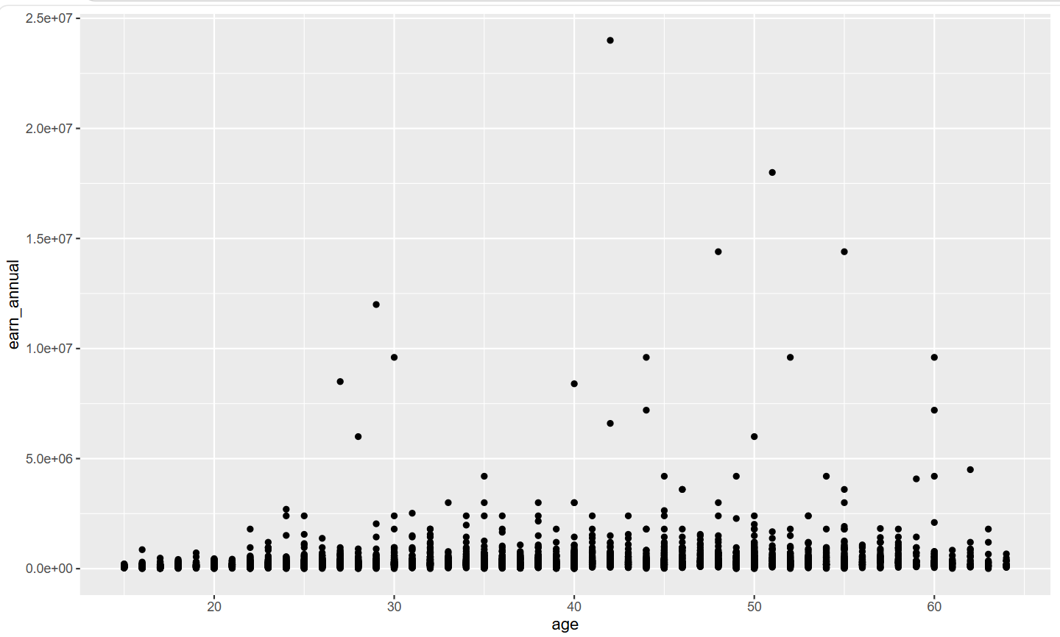
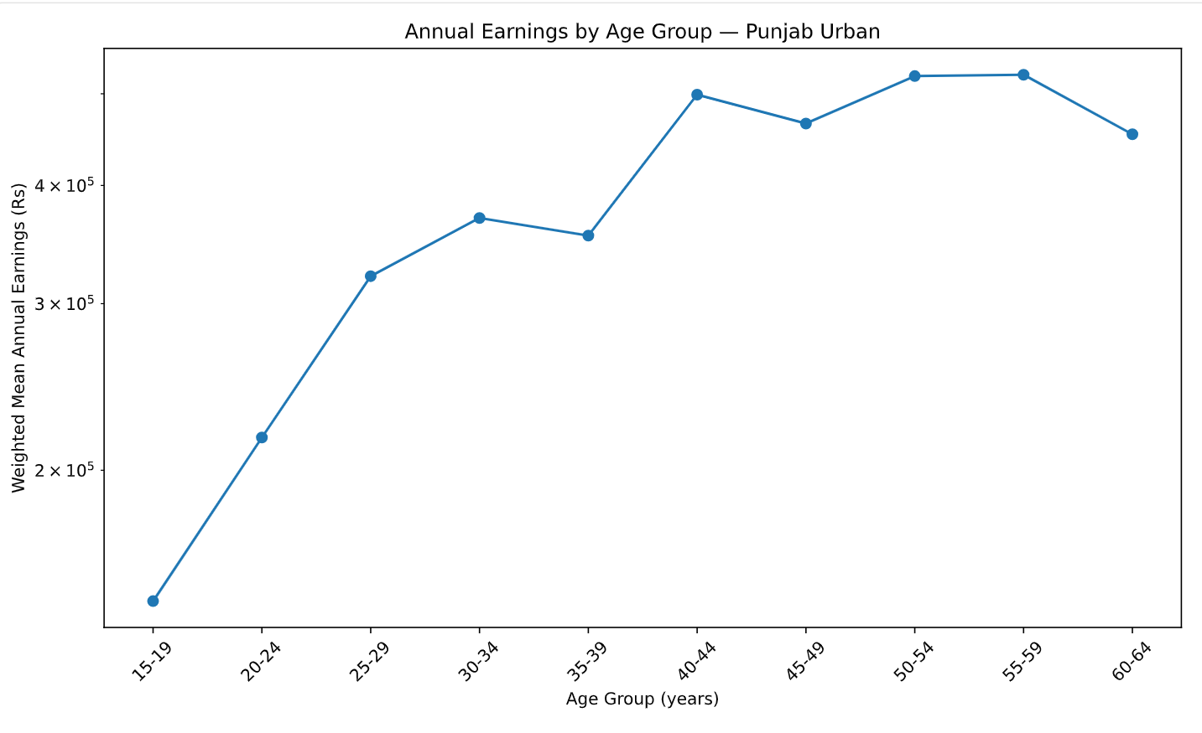
The makeover: default vs redesign
Question 4 · Better visual encoding makes the pattern easier to read
DEFAULT FIGURE
REDESIGNED FIGURE
Default scatter plot
Insert your default scatter plot SVG here
Redesigned age-earnings plot
Insert your redesigned age-earnings plot SVG here
Redesign changes: (1) log y-axis reveals variation across a wide earnings range; (2) transparency and jitter reduce overplotting in individual points; (3) weighted age-band means summarise the trend; (4) clearer labels and a finding-led title improve communication. The default reveals individual observations and spread within each age.

